Slide 1

Elastic Search For Dot Net Developers
By
David Betteridge
@da_betteridge

Slide 2

Tonight

Slide 3
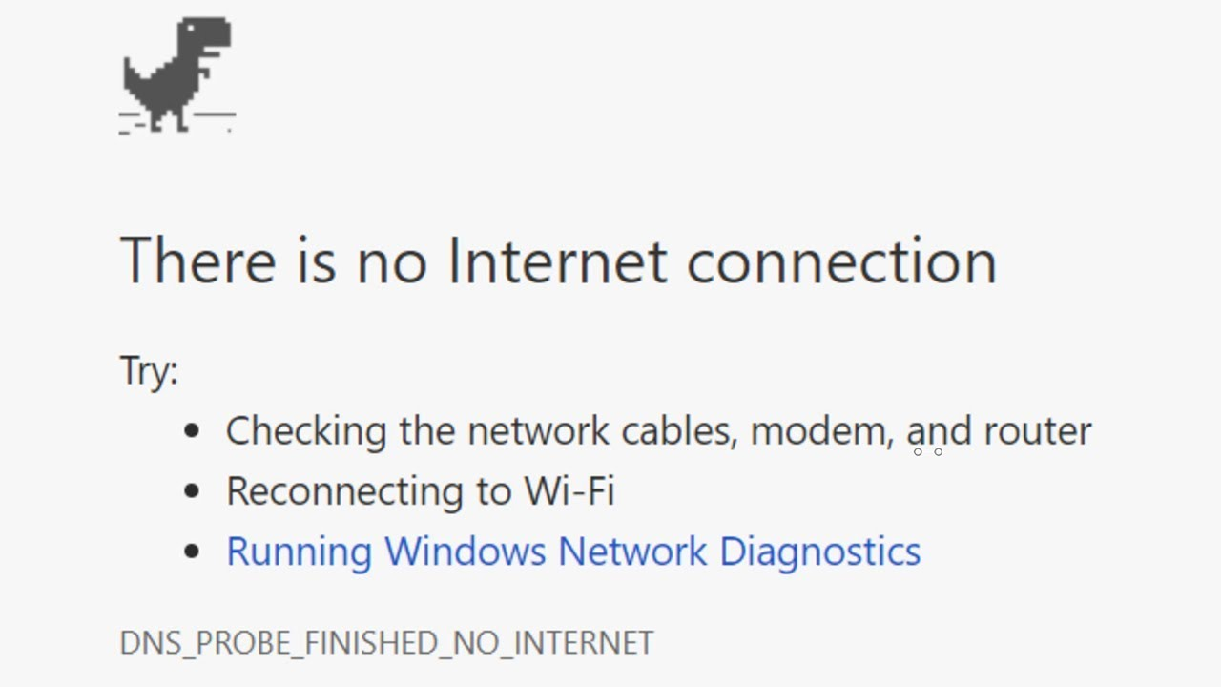


The Story

Slide 4
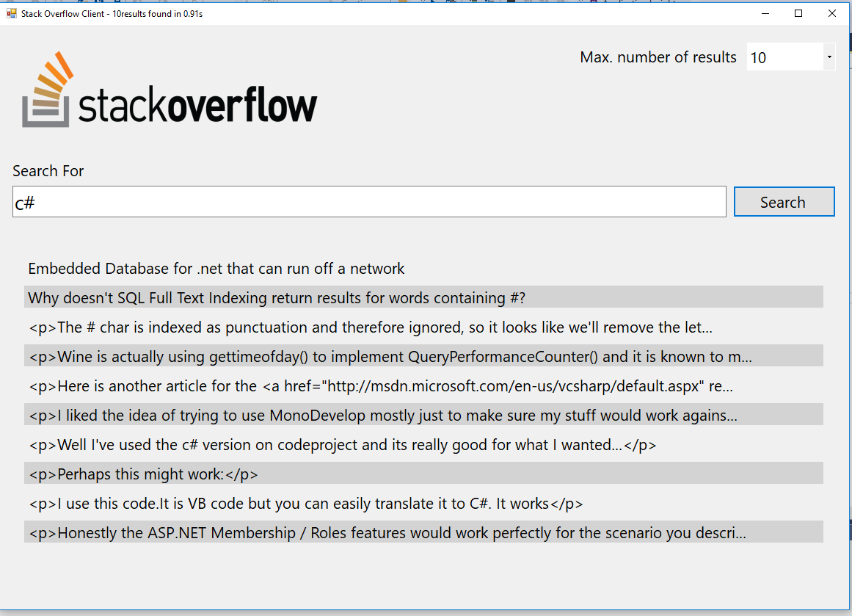
The Application

Slide 5
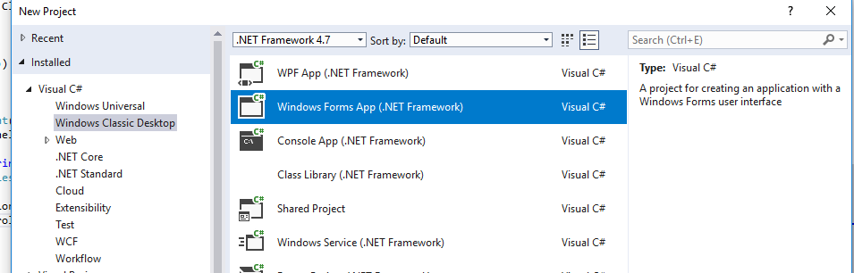
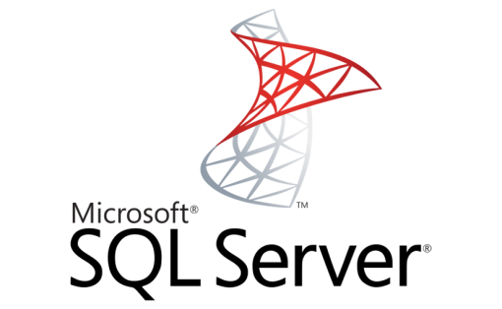
Architecture

Slide 6

Problems

Slide 7
Introducing Elastic Search
Elasticsearch is an open-source, broadly-distributable, readily-scalable, enterprise-grade search engine.
Accessible through an extensive and elaborate API, Elasticsearch can power extremely fast searches that support your data discovery applications.
Notes:
Getting started
Inverted Index
Rest API
NEST API
Bulk Import
Demo adding data
Demo search for data

Slide 8

Notes:
Elastic Search

Slide 9

Notes:
Log Stash

Slide 10

Notes:
Kibana

Slide 11
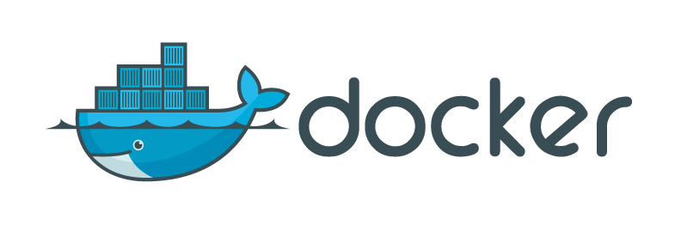
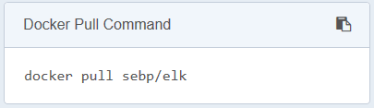
Getting Started
Notes:
docker run –p 5601:5601 –p 9200:9200 –p 5044:4044 –it -–name elk sebp/elk

Slide 12
REST
Notes:
Describe index type and id
Index/type/id id is optional
Result is created, then updated
The version number also goes up

Slide 13

Elasticsearch.Net

Slide 14

NEST

Slide 15

NEST Client
ElasticSearch.Net
REST
Notes:
So to summarise
The NEST Client is most developer friendly and is built using the ElastisSearch.Net client
The ElastisSearch.Net client can do everything that the REST client can do, built from it’s specification

Slide 16
The Application Revisited
Notes:
The elastic search version

Slide 17

Kibana

Slide 18
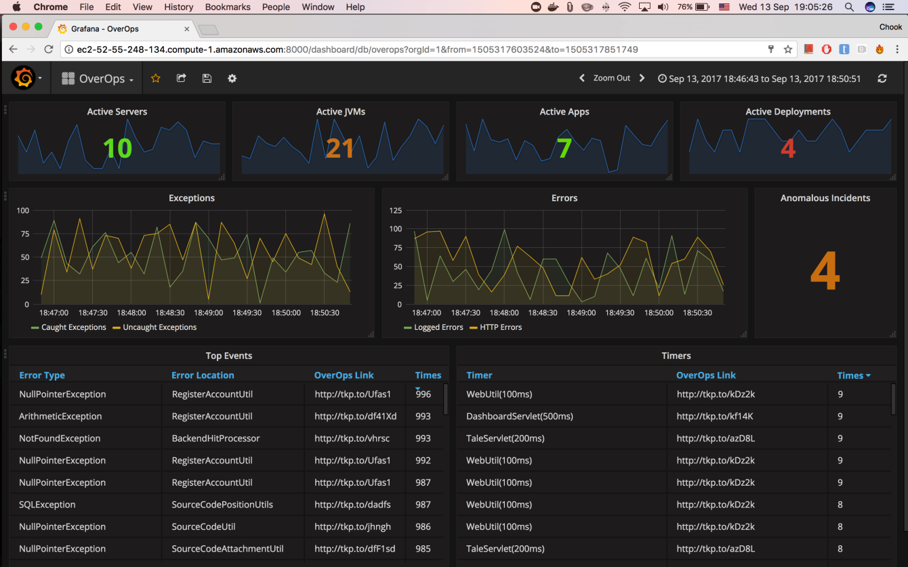
Grafana
Notes:
An alternative to Kibana is Grafana.
This allows data to be read from alternative source, and can query multiple elastic search clusters.
However as it’s more generic, I don’t find it as good for exploring data.
Grafana has decent role based security built in, Kibana needs the x-pack, which until recently you had to pay for.

Slide 19

Log Stash
Notes:
Centralize, Transform & Stash Your Data
Logstash is an open source, server-side data processing pipeline that ingests data from a multitude of sources simultaneously, transforms it, and then sends it to your favorite “stas
Requires the Java runtime – might be an issue on dotnet only servers.
Show config in iis manager
cd F:\logstash-6.2.2\bin
.\logstash -f ..\demo_conf
Load data
Show on map

Slide 20
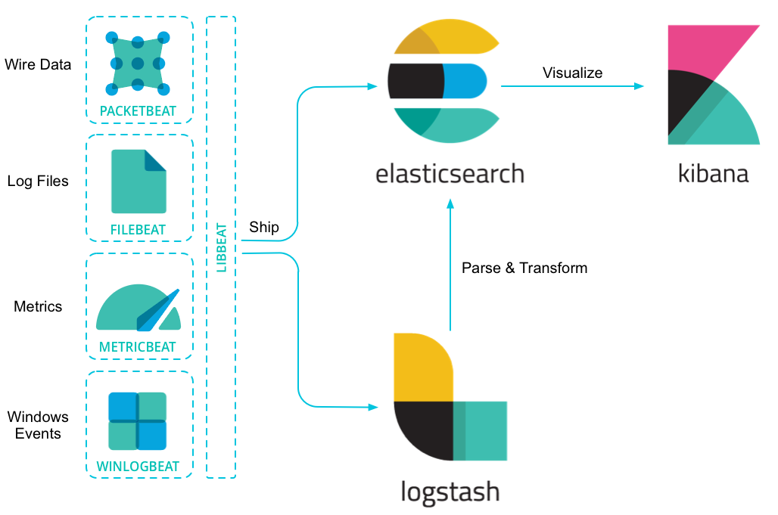
Beats
Notes:
The libbeat library is written in GoLang
Demo WinLogBeat
Cd into C:\Code\Elastic Search Talk\Software\winlogbeat-6.2.4-windows-x86_64
Show winlogbeat.yml (event logs + setup dashboard)
./winlogbeat.exe -c winlogbeat.yml
Show results in Kinaban (watch out data range)
There is an IIS beat coming soon

Slide 21

Security
Notes:
Which brings us on to security.
In the Microsoft world I was used to everything being secured by default. This isn’t the case with ELK stack.
Do you need security – well that depends on what you are using elastic search for. Backing the stackoverflow search client, then probably not. This is no different from having an internal sqlserver database.
If you are using it as a logging system, then yes. You don’t want people to be able to add/amend/delete logs.
When using Kibana, do you want everyone to see you data? You can use the Xpack to restrict what dashboards a person can see, and if they are allowed to edit them.
You could put an API gateway in front of Elastic search. So your application calls the API gateway, this verifies you are allowed to make the call, and the passes the class onto ES. You would configure ES so that it can only be called from the API gateway.

Slide 22
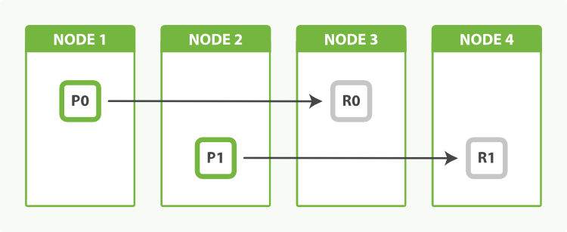
Scaling
Notes:
Nodes, Shards and replicas
Replicas can help read performance

Slide 23
Summary
We compared SQL Server to Elastic Search
Looked at various libraries to load data
Looked at some queries
Looked at some visualisation
Looked at log stash and beats
Discussed security
Discussed scaling
Questions?

